Slide 1
To save images as .png:
File -> Export -> File format: .png -> Save current slide only -> 1280x720
Notes:
1280 x 720 px

Slide 3


Slide 4
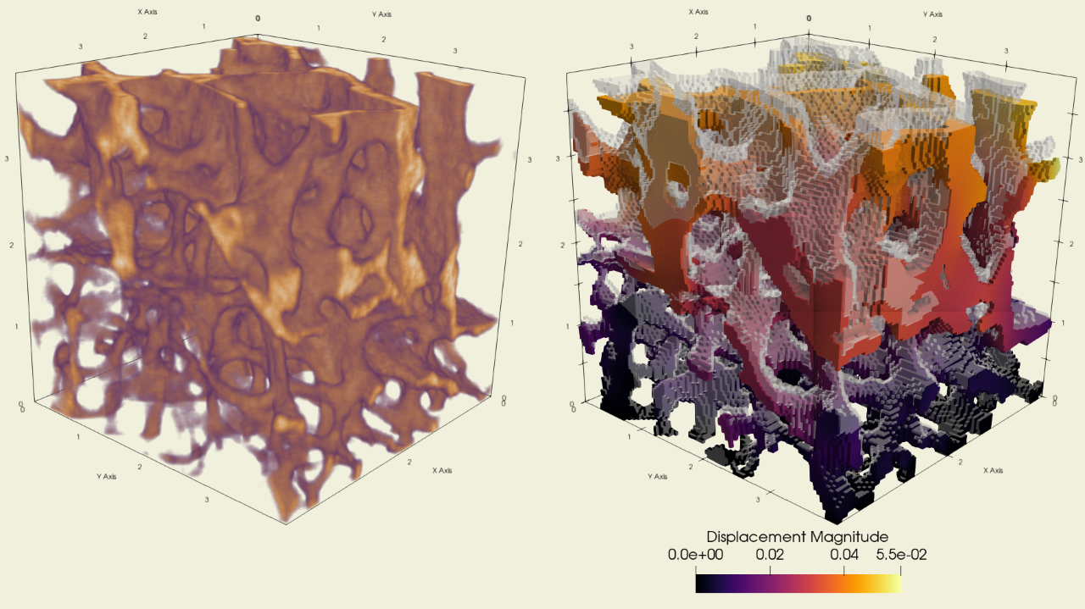

Slide 5
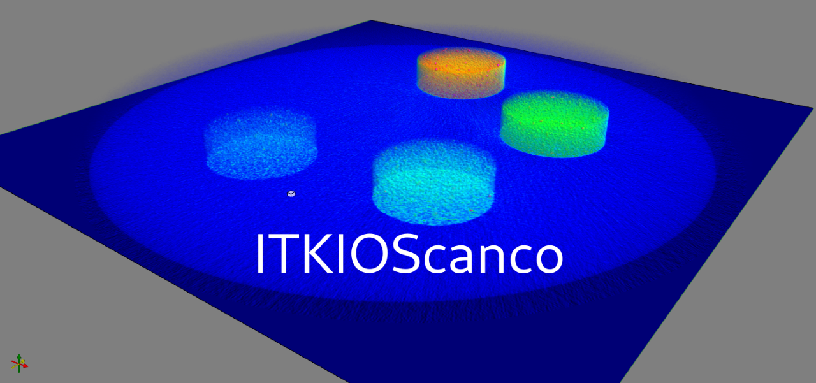

Slide 6
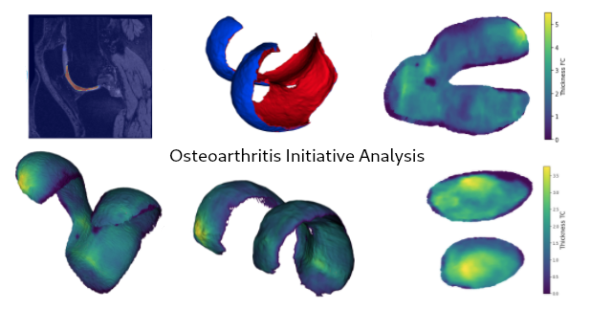

Slide 7
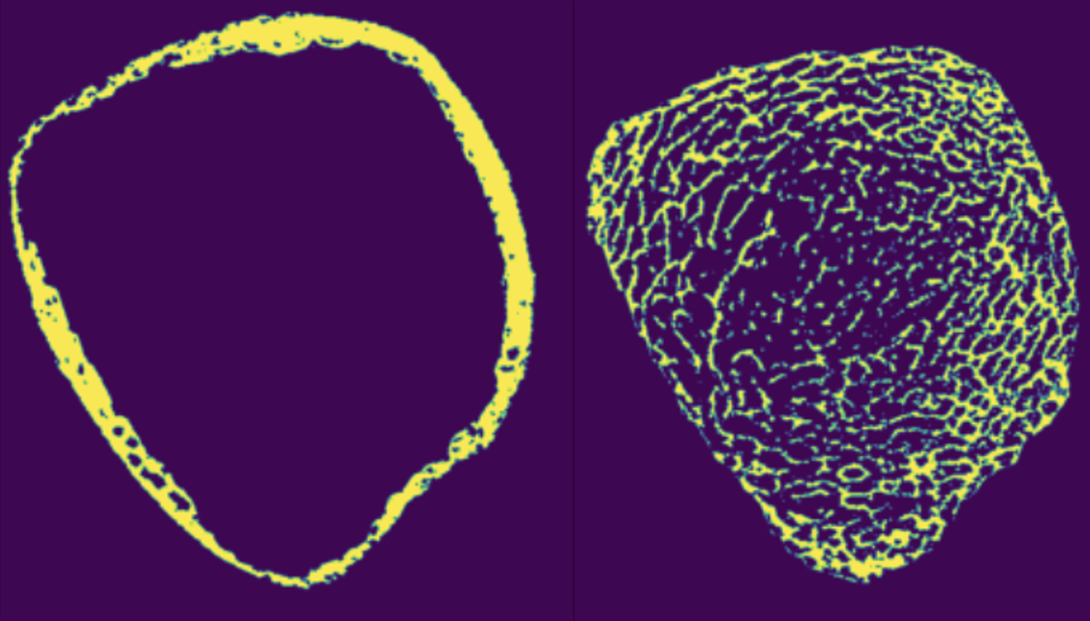

Slide 8
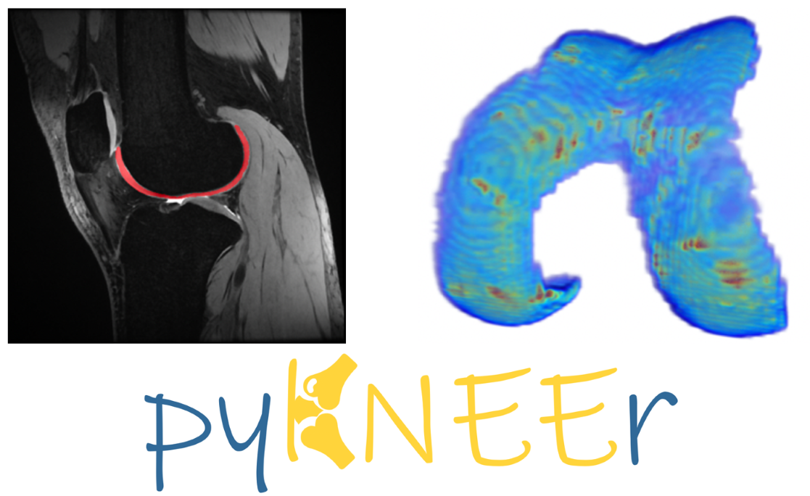

Slide 9


Slide 10


Slide 11
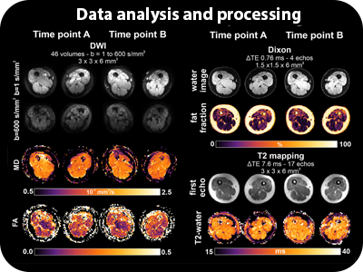

Slide 12
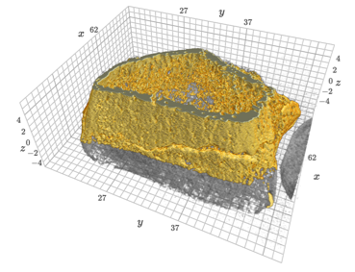

Slide 13
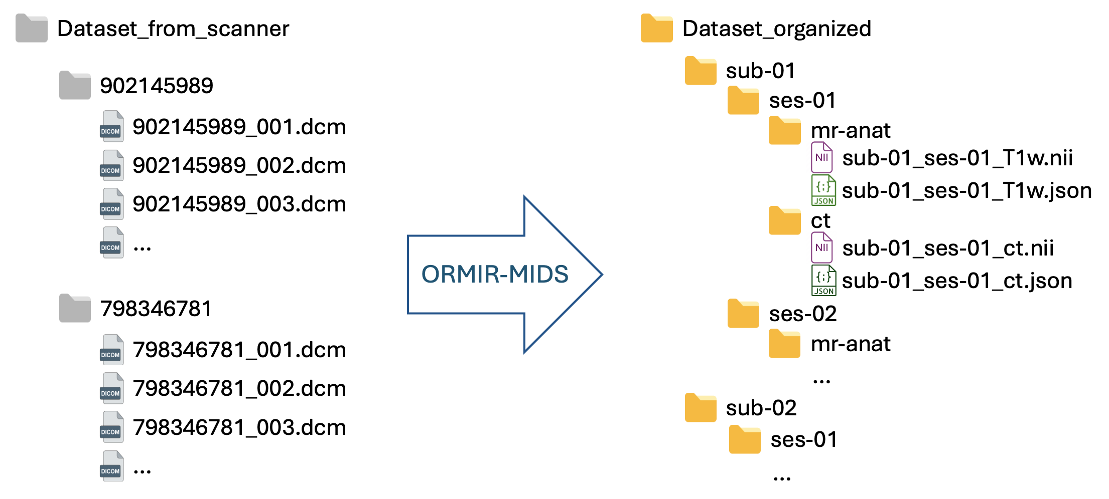

Slide 15
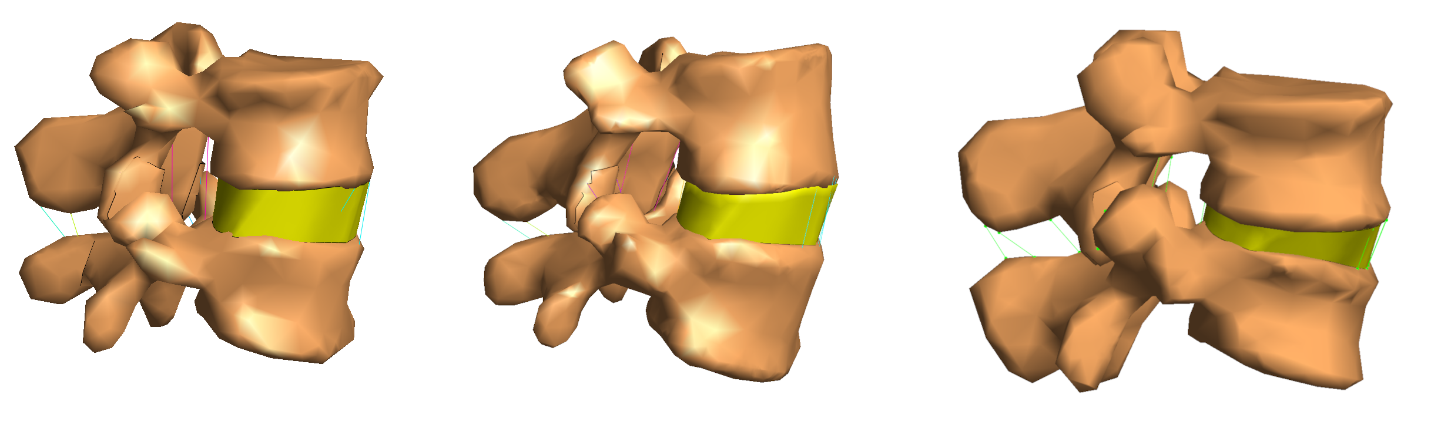

Slide 16
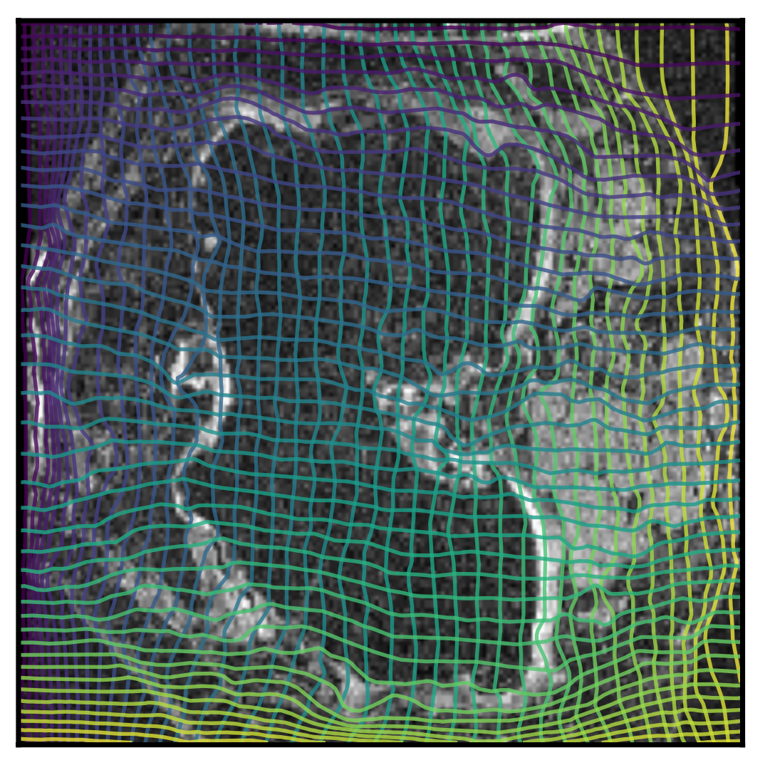

Slide 17
Coming soon!

Slide 18


